Slide 1
Building a Low-Cost Unidirectional File Transfer System
“Silence is a source of great strength.” — Lao Tzu
沉默是力量的源泉
— 老子
With A Custom Data Diode and Special TFTP Implementation
Presenter: Douglas Mun Date: 14 Aug 2025

Slide 2

Key points for today’s sharing
“When Silence is a feature not a bug.”
1. Why One-Way? The real threat landscape
2. The Core Idea: A simple protocol, reimagined for a silent world.
3. The Physical, Network and Protocol Layers: Light for security, fixing the ARP and killing ACKs to keep data alive.
“沉默是一种功能，而不是故障。”

Slide 3
Security by Physics, Not Policy
Why One-Way? The real threat landscape
Trust no one. Not even your own network.
Problem: Firewalls can fail. Physical air-gap is better—but how to move data safely?
Solution: Data Diode—hardware-enforced one-way channel.
| Application | Risk Mitigated |
|--------------------------|-------------------------------------------------|
| OT/SCADA Log Shipping | Prevents ransomware from jumping from IT to OT |
| Immutable Backups | Ransomware can’t encrypt what it can’t reach |
| Intelligence Ingestion | Classified networks receive updates safely |
Innovation Angle: Not just a tool—it's a philosophy of data flow.

Slide 4
Custom Physical Data Diode
The Physical Layers: Light for security
Security at Layer 1: When Light Enforces Trust.
Solution: Data Diode, a hardware-enforced one-way channel.
[Sender PC Ethernet]
↓
[Media Converter](TX) → [Fibre Cable] → (RX)[Media Converter]
↓
[Receiver PC Ethernet]
Data Flow: Arrow is one-way only, no light path back.
Receiver Media Converter: TX fibre port disconnected.
UDP Protocol: Custom TFTP with no ACKs. Immune to protocol exploits.
Innovation Angle: Use a single-mode SC fibre cable over a media converter.

Slide 5
The Networking Challenge
The Protocol Layers: Fixing the ARP paradox
The Static ARP Trick: The Magic of Pre-Knowledge.
Analogy: A teacher shouting into a soundproof room — no feedback, no visibility.
There are minimum two Networking Challenges to overcome:
| Layer | Problem | Consequence |
+----------------+------------------------+-------------------------------+
| L2 (Data Link) | ARP requires a reply | Sender can’t resolve MAC addr |
| L4 (Transport) | TFTP expects ACKs | Transfer stalls after 1st blk |
Assumptions: Receiver is ready listening. Just keep sending.

Slide 6
The Networking Challenge (cont)
The Protocol Layers: Fixing the ARP paradox
The Silence Problem: Designing for a Deaf Receiver.
The Shouting Sender over ARP:
Sender: “Who has 192.168.1.100?"
Receiver: (silent)
Sender: “No one answered. Giving up."
Fixed via adding a static ARP entry on the Sender PC:
arp -s 192.168.1.100 00:0A:95:9D:68:16
Benefits:
Bypasses ARP request
Hard Coded MAC address
Prevents ARP spoofing
Insight: We’re not discovering the network—we’re declaring it.

Slide 7
Why TFTP over UDP? Not TCP & FTP
The Core Idea: A simple protocol, reimagined for a silent world
Trivial File Transfer Protocol (TFTP) is the Perfect Minimalist Protocol
Why Not TCP?
TCP needs 3-way handshake
Receiver can’t respond → connection fails
UDP:
No handshake
Fire-and-forget → ideal for one-way
TFTP:
Simple block structure
Easy to code
Conclusion: TFTP is simple hence an ideal file transfer protocol over a one-way link.

Slide 8
Standard TFTP PUT flow
The Protocol Layers: TFTP file transfer
The Postcard Protocol with a Receipt System.
TCP: Like a phone call—handshakes, flow control.
UDP: Like a postcard—no guarantee of arrival.
TFTP uses ACKs to simulate reliability.
Sender Receiver
| — WRQ (file.txt) —> |
| <— ACK (block 0) — |
| — DATA (block 1) —> |
| <— ACK (block 1) — |
| — DATA (block 2) —> |
Fatal Flaw: Every send requires a reply. No replies = no transfer.
Conclusion: TFTP fails on a one-way link. But works once the dependency is removed.

Slide 9
Special TFTP PUT flow
The Protocol Layers: TFTP file transfer
The Opera Artist with an Audience that Never Applauds
One-way TFTP without ACKs.
Sender Receiver
| — WRQ (file.txt) —> |
| — DATA (block 1) —> |
| — DATA (block 2) —> |
| — DATA (block n) —> |
Sender uses timing delays between sending packets to ensure the best chance of packet being received.
Receiver flush DATA to disk immediately to ensure the buffer doesn’t overflows, leading to data loss.
Sender: Controlled Firehose: The 5ms Rule.
Start → Read Input File → Send WRQ → Wait 10ms
Loop:
Read 512 bytes → Send DATA → Sleep 5ms
If <512 bytes → Last block → Break
Close
Receiver: Write Now, Ask Never: The Philosophy of Resilience.
Start → listen → Parse WRQ → Write Output File
Loop: Recv DATA Write DATA to file → Flush file to disk
Last block → Clean-up
Close

Slide 10
Breaking Assumption & Reflections
The Core Idea: A simple protocol, reimagined for a silent world
Lessons from building a Custom Data Diode and Special TFTP Implementation
We assumed networks were conversational but an one-way broadcast channel is possible.
Limitations for future work: No error correction
No Auth/Encryption Manual ARP setup
No congestion control
Reflections:
Security can be physical
Reliability doesn’t need replies
Timing replaces ACKs
Final Thought: Sometimes, the most powerful thing a system can do is say nothing at all.

Slide 11
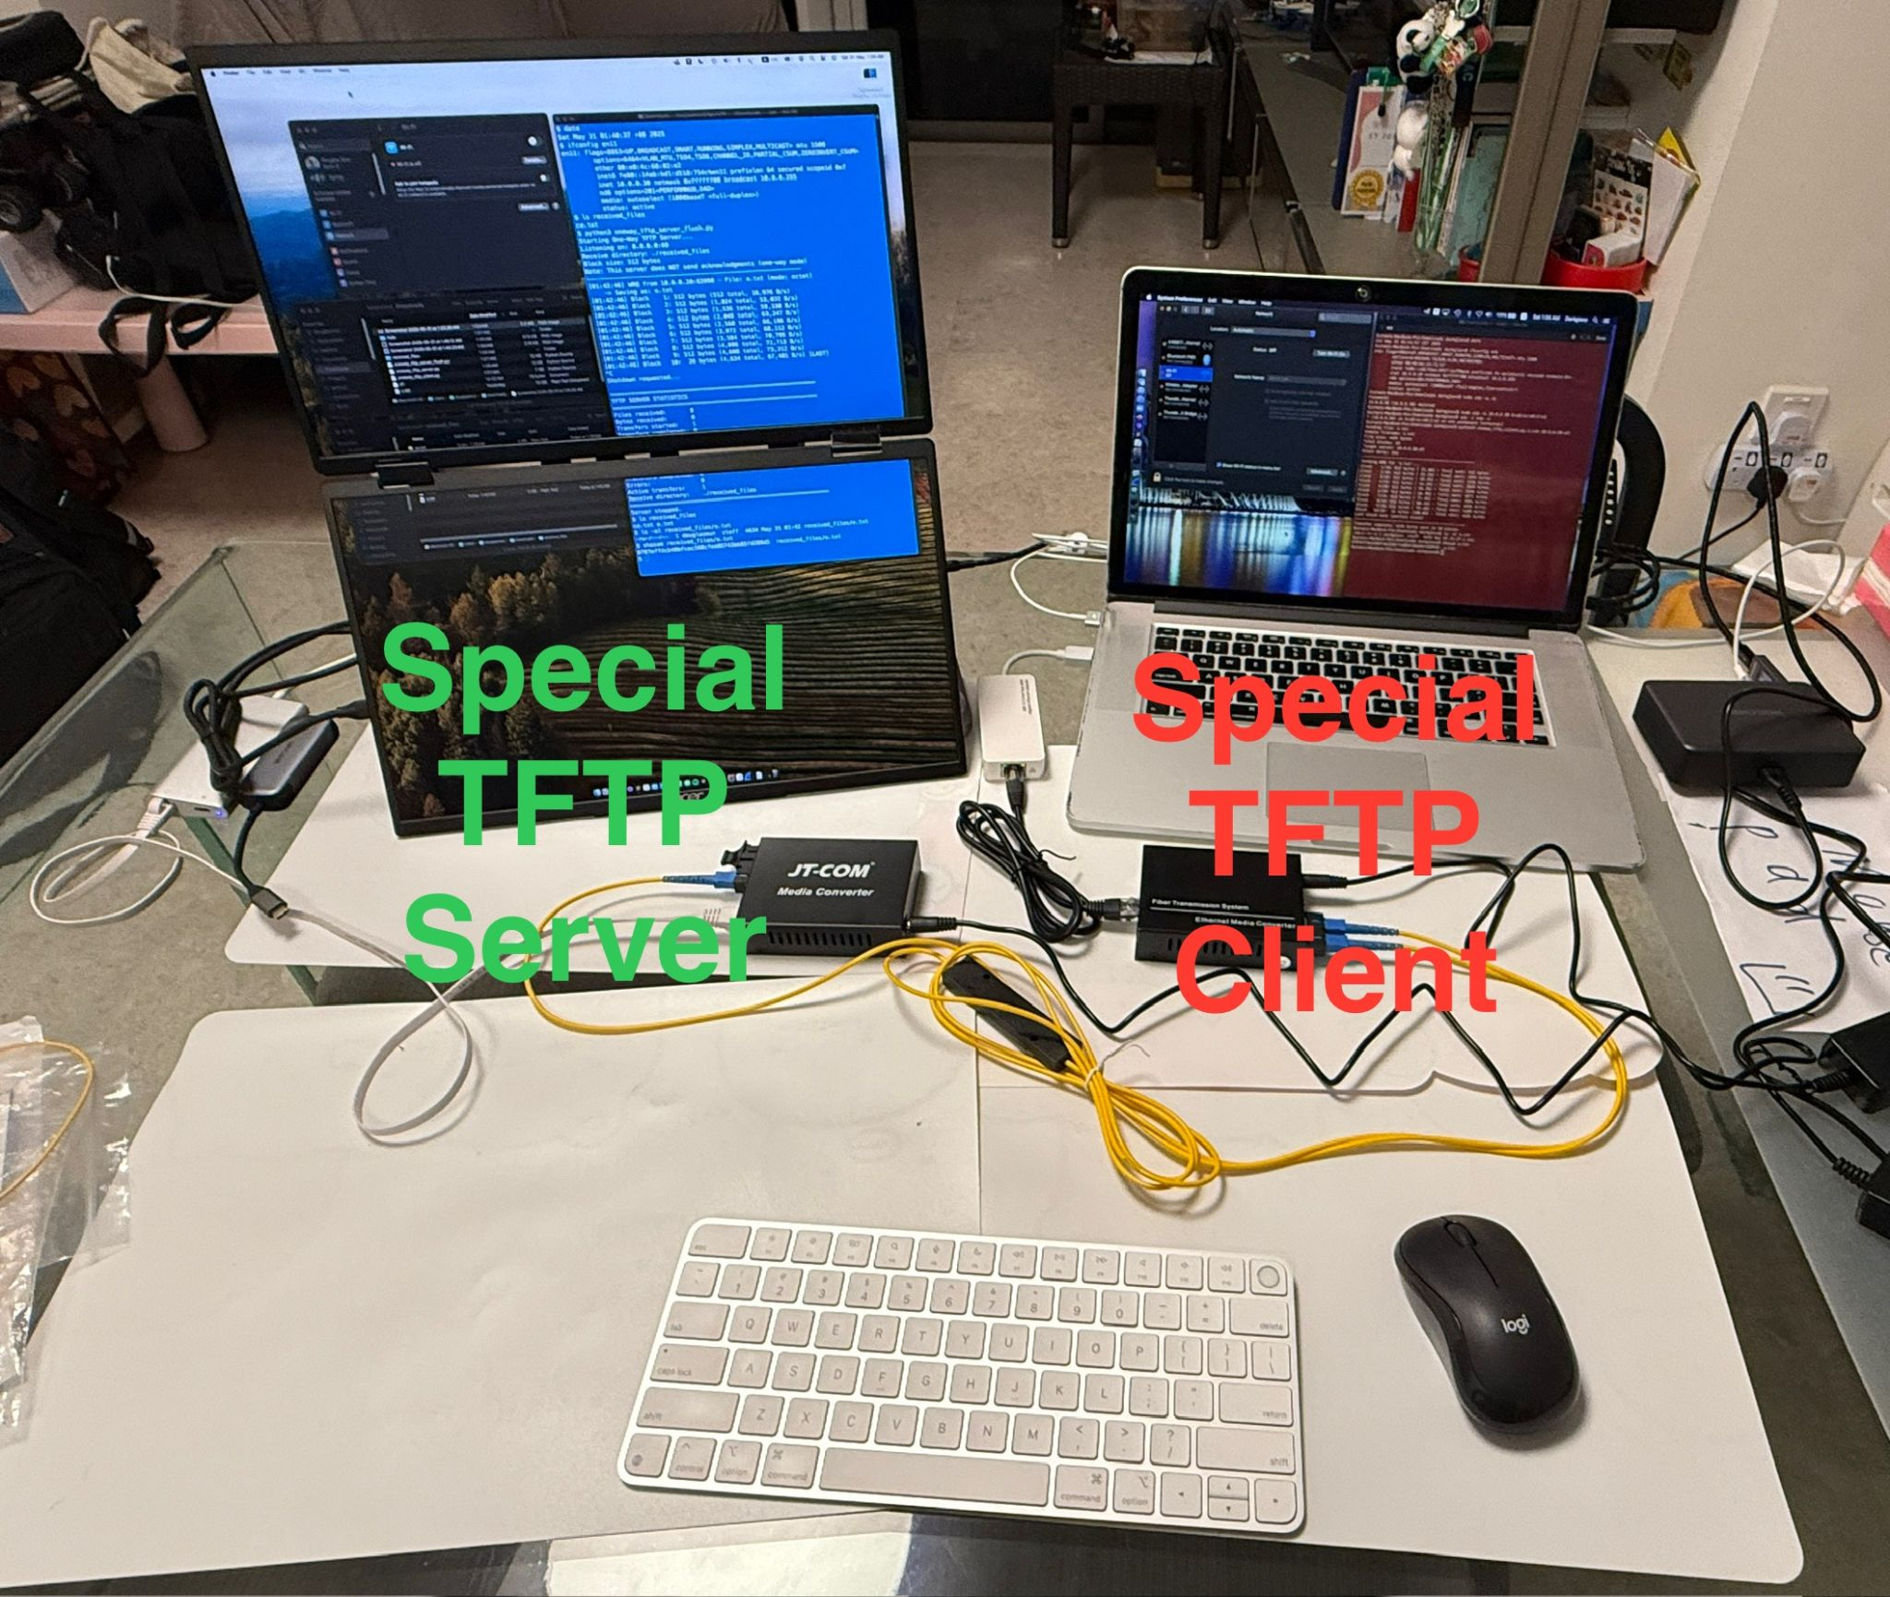
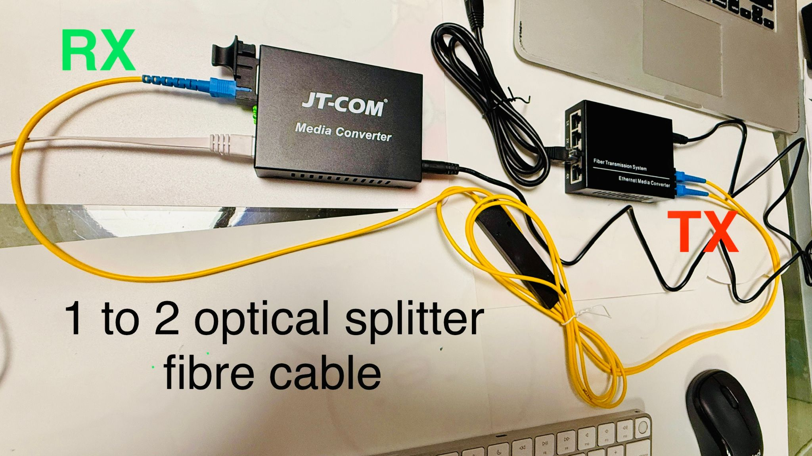
Demo
Time
Let’s Explore to Learn and Grow Together

Slide 12
Thank you for your support!
“Those who know do not speak; those who speak do not know.” — Lao Tzu
知者不言，
言者不知。 — 老子
For feedback & presentation material: douglas_mun@csa.gov.sg

